Slide 1
Introduction To Cloud Computing

Slide 2
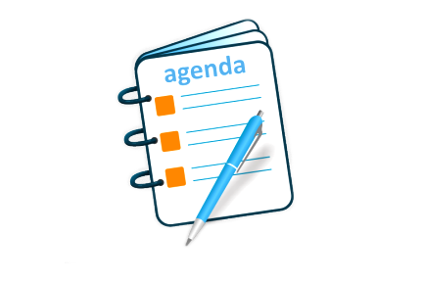
Agenda
Definition of Cloud Computing
Characteristics of Cloud Computing
Cloud Computing Architecture
Types of Cloud and Computing Services Model
What is Cloud Security?
Applications of Cloud Computing

Slide 3
Cloud Computing Definition

Slide 4
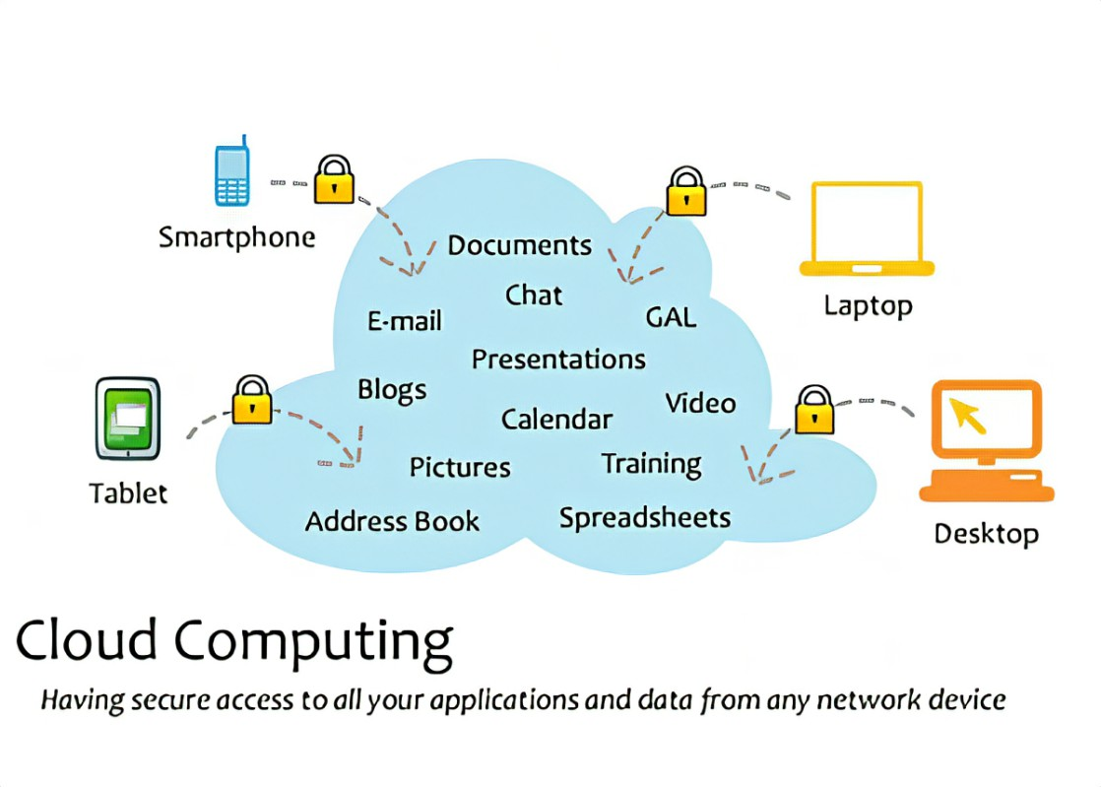
What Is Cloud Computing?
Cloud computing means storing and accessing the data and programs on remote servers that are hosted on the internet instead of the computer’s hard drive or local server
Cloud computing is on-demand access, via the internet, to computing resources-applications, servers (physical servers and virtual servers), data storage, development tools, networking capabilities, and more like hosted at a remote data centre managed by a cloud services provider (or CSP). (AWS, Azure, GCP, Cisco Cloud Services)

Slide 5
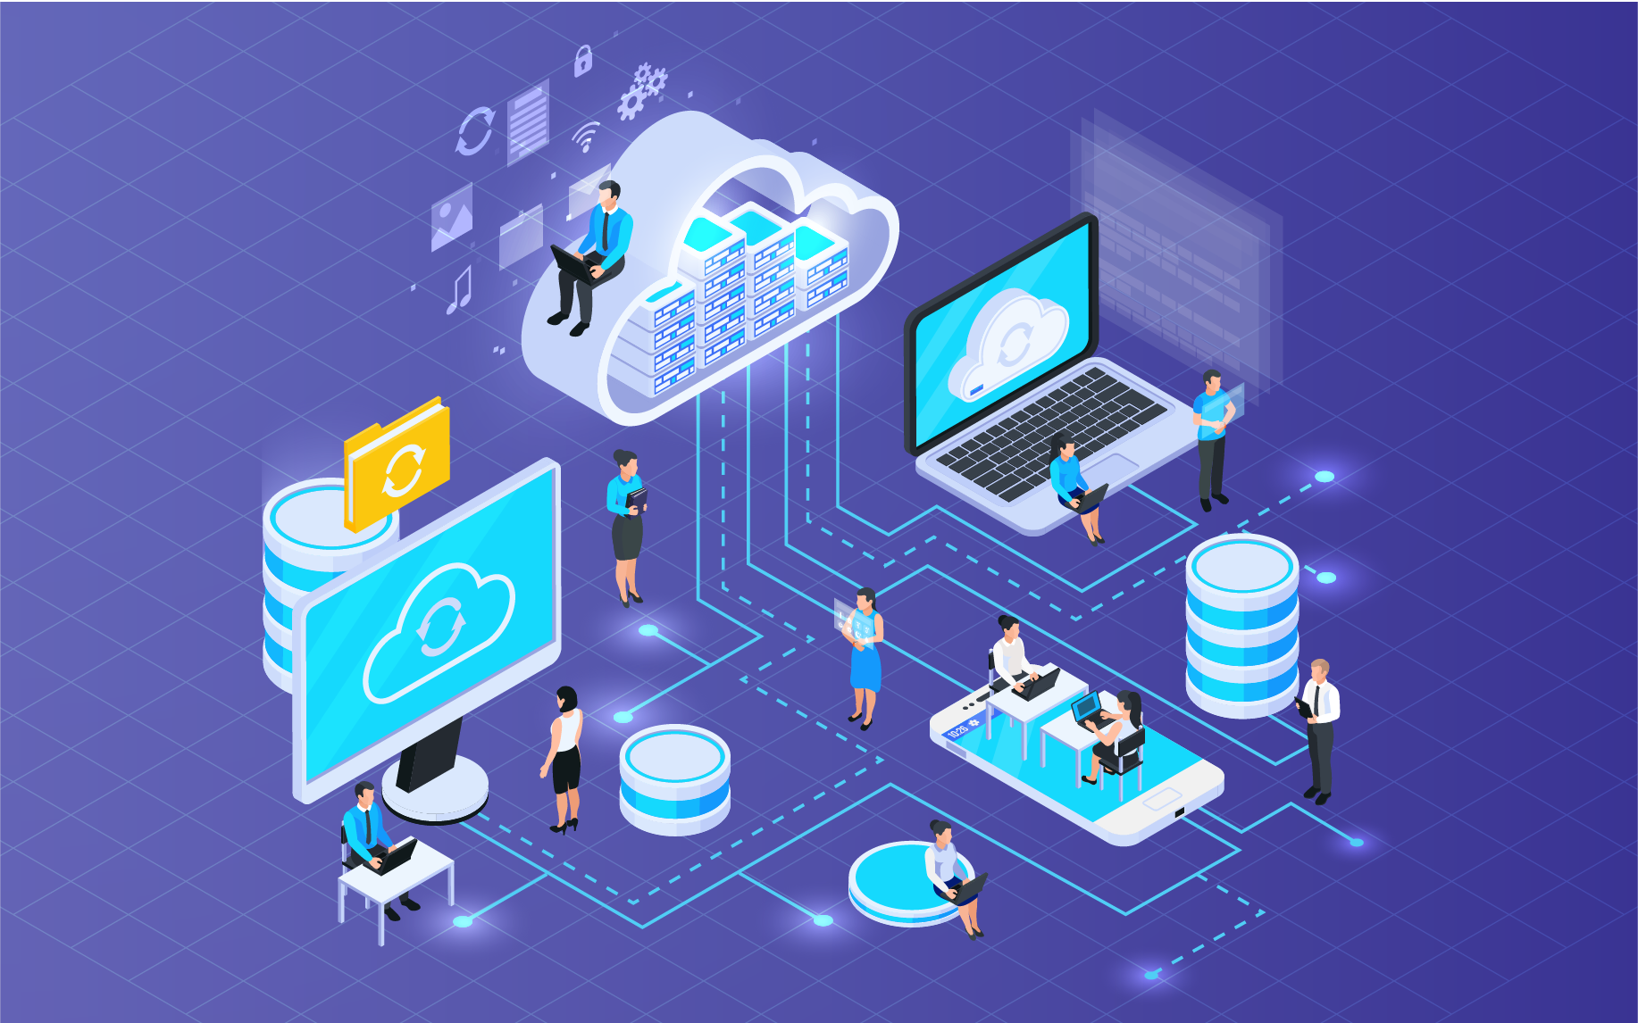
What Is Cloud Computing?
It is a service rather than a product.
No need to install software and high configured machinery.
You can access cloud based applications through a web browser or a light weight desktop or mobile app.
Service is fully managed by service provider and only you need is good internet speed
A simple examples are Gmail, yahoo, Hotmail etc

Slide 6

Why Cloud Computing?
Cloud computing takes away most of the technical workloads. You can plug into your servers via the internet. With cloud adoption, data centers are slowly turning into legacy systems.
With cloud computing, businesses have:
Less technical workloads
Lower security risk
Flexible infrastructure
Pay-as-you-go pricing model
Global scaling

Slide 7
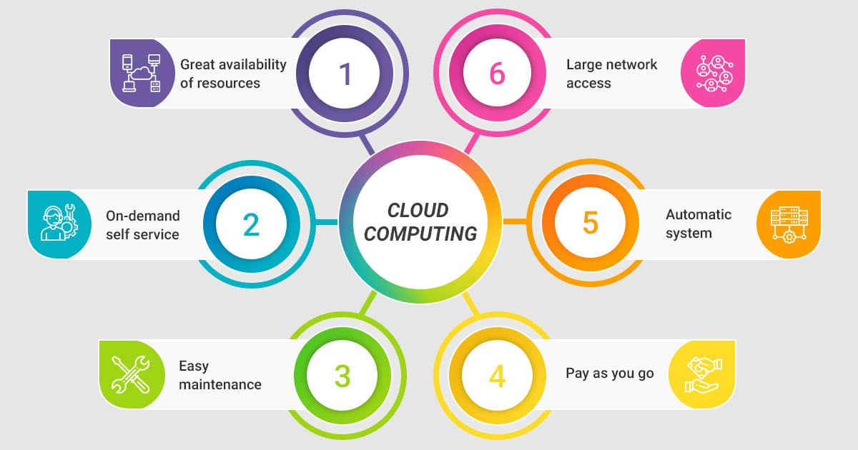
Why Cloud Computing?

Slide 8
Where Can I Access Cloud Computing?
There are many cloud computing services available to individual users, but the "big three" are:
Amazon Web Services (AWS)
Google Cloud Platform (GCP)
Microsoft Azure
The service you choose will depend on:
The scale of your business
Your business structure
How much of the work you want to outsource

Slide 9
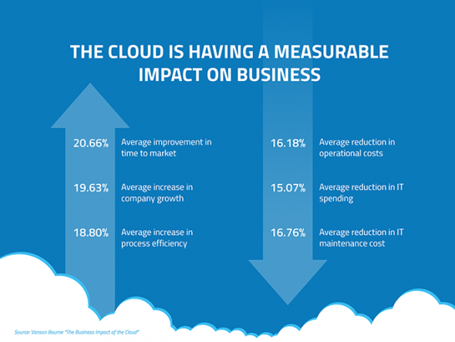
Cloud Computing: Impact On Business

Slide 10
Characteristics Of Cloud Computing

Slide 11
Characteristics Of Cloud Computing:
Cloud computing is composed of 5 essential characteristics:
On-demand Self Service
Broad Network Access
Resource Pooling
Rapid Elasticity
Measured Service

Slide 12
Characteristics Of Cloud Computing:
On-demand self-service: Users can provision computing resources, such as servers and storage, as needed, without the need for human intervention or interaction with a service provider.
2.Broad network access: Cloud resources can be accessed from anywhere in the world through various devices, such as desktops, laptops, tablets, and smartphones, using standard internet protocols.
3.Resource pooling: Cloud providers can share computing resources across multiple users, enabling efficient use of resources and allowing users to scale up or down as needed.
4.Rapid elasticity: Cloud providers can quickly and easily provision additional computing resources as needed, allowing users to scale up or down in response to changes in demand.
5.Measured service: Cloud providers can monitor and measure resource usage, charging users only for the resources they consume.

Slide 13
Cloud Computing Architecture

Slide 14
Cloud Computing Architecture
Cloud computing technology is used by both small and large organizations to store the information in cloud and access it from anywhere at anytime using the internet connection.
Cloud computing architecture is a combination of service-oriented architecture and event-driven architecture.
Cloud computing architecture is divided into the following two parts -
Front End
Back End

Slide 15
Cloud Computing Architecture
Front End:
The front end is used by the client.
Back End:
The back end is used by the service provider.
It contains client-side interfaces and applications that are required to access the cloud computing platforms.
The front end includes web servers (including Chrome, Firefox, internet explorer, etc.), thin & fat clients, tablets, and mobile devices.
It manages all the resources that are required to provide cloud computing services.
It includes a huge amount of data storage, security mechanism, virtual machines, deploying models, servers, traffic control mechanisms, etc.

Slide 16
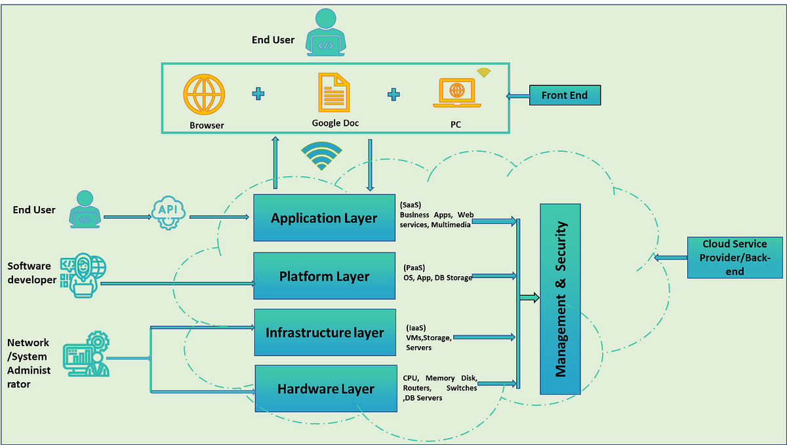
Cloud Computing Architecture

Slide 17
Components Of Cloud Computing Architecture
There are the following components of cloud computing architecture -
1. Client Infrastructure
Client Infrastructure is a Frontend component. It provides GUI (Graphical User Interface) to interact with the cloud.
2. Application
The application may be any software or platform that a client wants to access.
3. Service
A Cloud Services manages that which type of service you access according to the client’s requirement. Cloud computing offers the following three type of services:
Saas (Software as a Service)
Paas (Platform as a Service)
Iass (Infrastructure as a Service)

Slide 18
Components Of Cloud Computing Architecture
4. Runtime Cloud
Runtime Cloud provides the execution and runtime environment to the virtual machines.
5. Storage
Storage is one of the most important components of cloud computing. It provides a huge amount of storage capacity in the cloud to store and manage data.
6. Infrastructure
It provides services on the host level, application level, and network level. Cloud infrastructure includes hardware and software components such as servers, storage, network devices, virtualization software, and other storage resources that are needed to support the cloud computing model.

Slide 19
Components Of Cloud Computing Architecture
7. Management
Management is used to manage components such as application, service, runtime cloud, storage, infrastructure, and other security issues in the backend and establish coordination between them.
8. Security
Security is an in-built backend component of cloud computing. It implements a security mechanism in the back end.
9. Internet
The Internet is medium through which front end and back end can interact and communicate with each other.

Slide 20
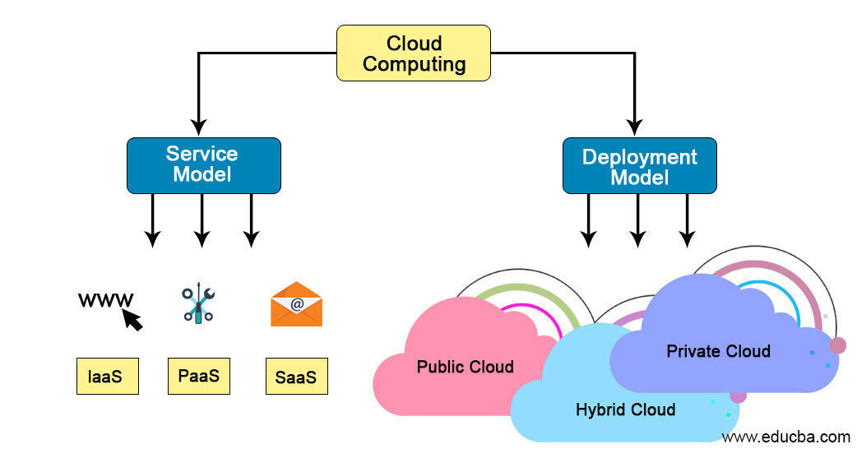
Cloud Computing Architecture

Slide 21
Types Of Cloud

Slide 22
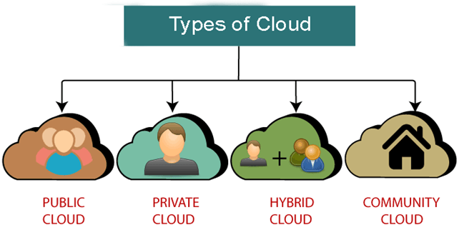
Types Of Cloud
There are the following 4 types of cloud that you can deploy according to the organization's needs-

Slide 23
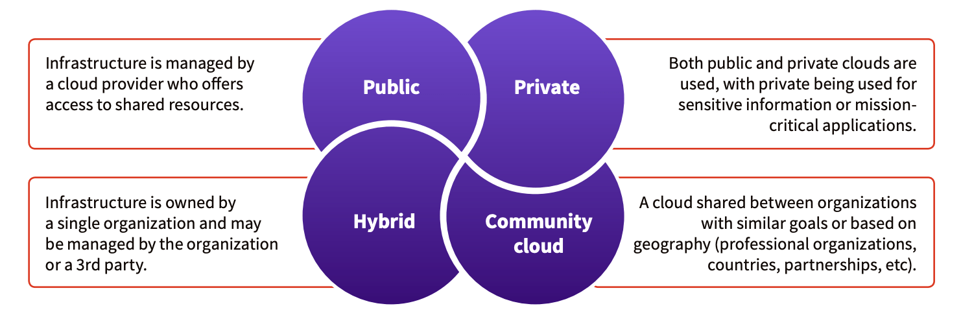

Slide 24
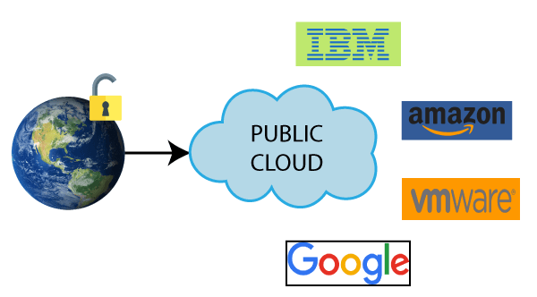
Public Cloud
Public cloud is open to all to store and access information via the Internet using the pay-per-usage method.
In public cloud, computing resources are managed and operated by the Cloud Service Provider (CSP).
It is accessible by the general public, so there is no limit to the number of users.
Examples :-
Amazon elastic compute cloud (EC2), IBM Smart Cloud Enterprise, Microsoft, Google App Engine, Windows Azure Services Platform.

Slide 25
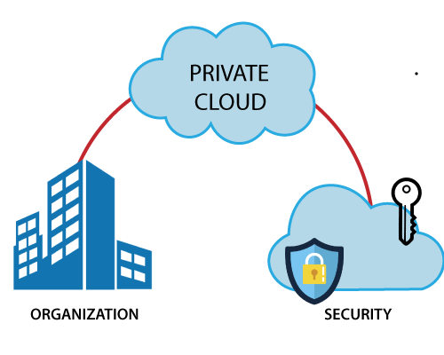
Private Cloud
Private cloud is also known as an internal cloud or corporate cloud.
It is used by organizations to build and manage their own data centers internally or by the third party.
It can be deployed using Opensource tools such as Open stack and Eucalyptus.
Based on the location and management, National Institute of Standards and Technology (NIST) divide private cloud into the following two parts-
1.On-premise private cloud
2.Outsourced private cloud

Slide 26
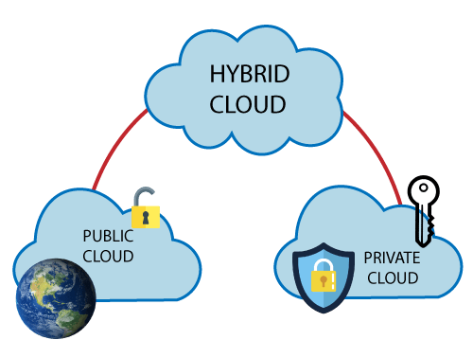
Hybrid Cloud
Hybrid Cloud is a combination of the public cloud and the private cloud. we can say:
Hybrid Cloud = Public Cloud + Private Cloud
Hybrid cloud is partially secure because the services which are running on the public cloud can be accessed by anyone, while the services which are running on a private cloud can be accessed only by the organization's users.
Example: Google Application Suite (Gmail, Google Apps, and Google Drive), Office 365 (MS Office on the Web and One Drive), Amazon Web Services.

Slide 27
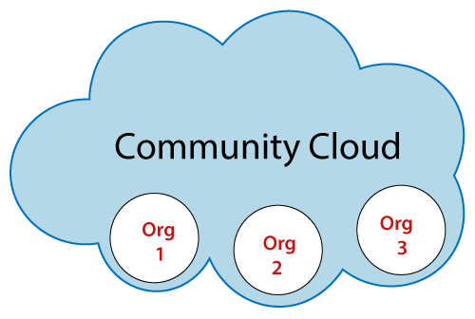
Community Cloud
Community cloud allows systems and services to be accessible by a group of several organizations to share the information between the organization and a specific community.
It is owned, managed, and operated by one or more organizations in the community, a third party, or a combination of them.
Example: Health Care community cloud

Slide 28
Cloud Service Model

Slide 29
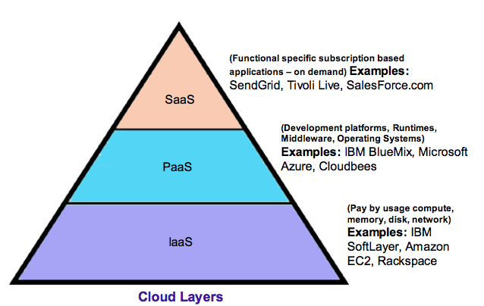
Cloud Service Model
Cloud services can be distinguished based on their business model, functionality, and billing systems.
There are the following three types of cloud service models -
1. Software as a Service (SaaS)
2. Platform as a Service (PaaS)
3. Infrastructure as a Service (IaaS)

Slide 30
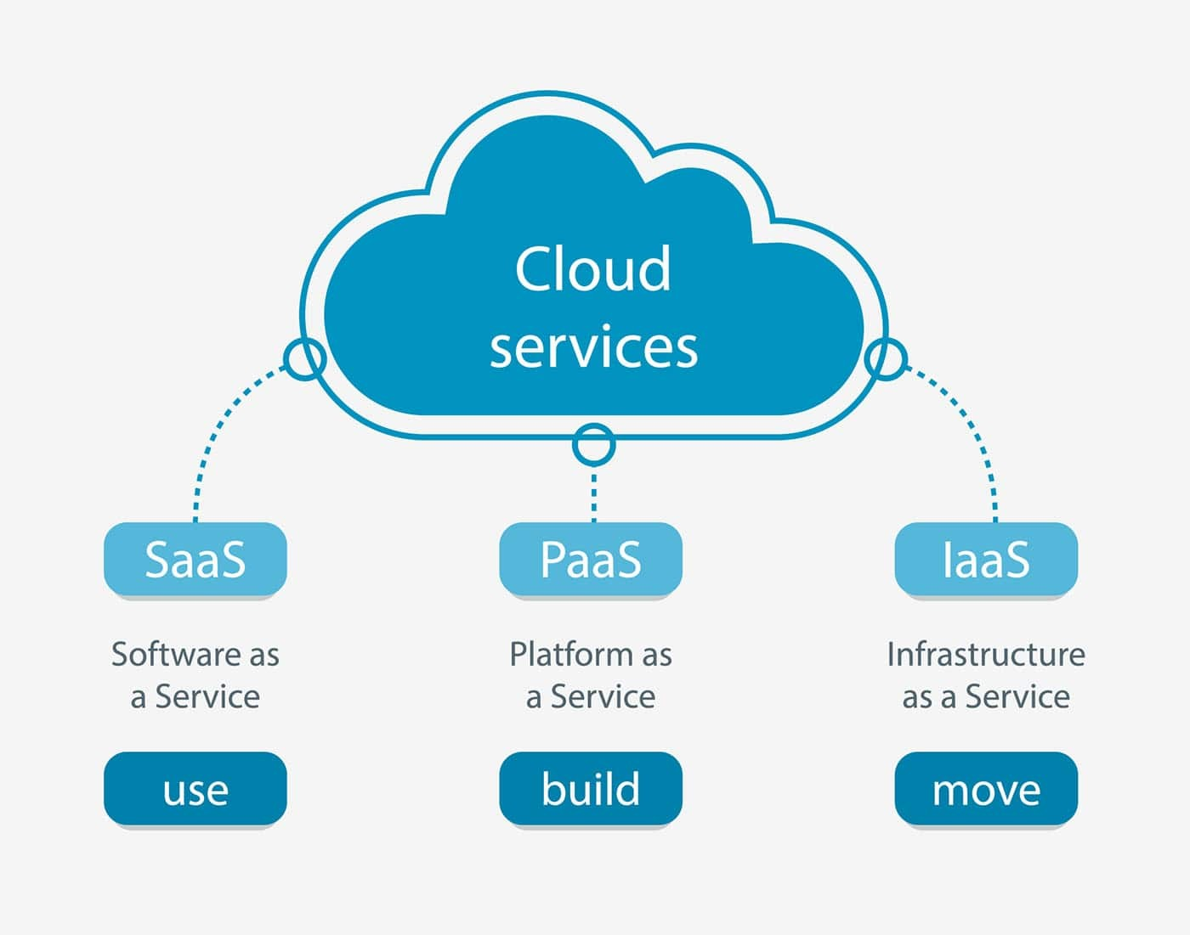
Cloud Service Model

Slide 31
1. Software as a Service (SaaS)
SaaS is also known as "on-demand software".
It is a software in which the applications are hosted by a cloud service provider. Users can access these applications with the help of internet connection and web browser.
Instead of purchasing the solution one time, as if it would be a product, the software is delivered continuously — like a service.
SaaS services provide companies with data storage and management features. Often, these are services for process automation, marketing, collaboration, and data organization.

Slide 32
Characteristics Of SaaS
There are the following characteristics of SaaS –
Managed from a central location
Hosted on a remote server
Accessible over the internet
Users are not responsible for hardware and software updates. Updates are applied automatically.
The services are purchased on the pay-as-per-use basis

Slide 33
1. Examples: Software as a Service (SaaS)
Examples of SaaS:
Google’s G Suite: top cloud service provides businesses with access to management, communication, and organization tools and uses cloud for data computing. Gmail, Google Drive, Google Docs, Google Planner, Hangouts — these are all SaaS tools that can be accessed anytime and anywhere.
Microsoft Office 365: the series of web services that provide business owners and individuals with access to Microsoft Office main tools directly from their browsers. Users can access Microsoft editing tools, business email, communication instruments, and documentation software.
Salesforce: The most popular CRM on the market that unites marketing, communication, e-commerce. Salesforce uses cloud computing benefits to provide access to its services and internal data. Business owners can keep track of their sales, client relations, communications, and relevant tasks from any device. Salesforce can be integrated into the website — the information about incoming leads will be sent to the platform automatically.

Slide 34
2. Platform as a Service (PaaS)
Platform as a Service (PaaS) provides a runtime environment.
PaaS cloud computing platform is created for the programmer to develop, test, run, and manage the applications.
With PaaS, the cloud provider hosts everything—servers, networks, storage, operating system software, middleware, databases—at their data centre.
Developers simply pick from a menu to ‘spin up’ servers and environments they need to run, build, test, deploy, maintain, update, and scale applications.

Slide 35
Characteristics Of PaaS
Characteristics of PaaS -
Accessible to various users via the same development application.
Integrates with web services and databases.
Builds on virtualization technology, so resources can easily be scaled up or down as per the organization's need.
Support multiple languages and frameworks.
Provides an ability to "Auto-scale".

Slide 36
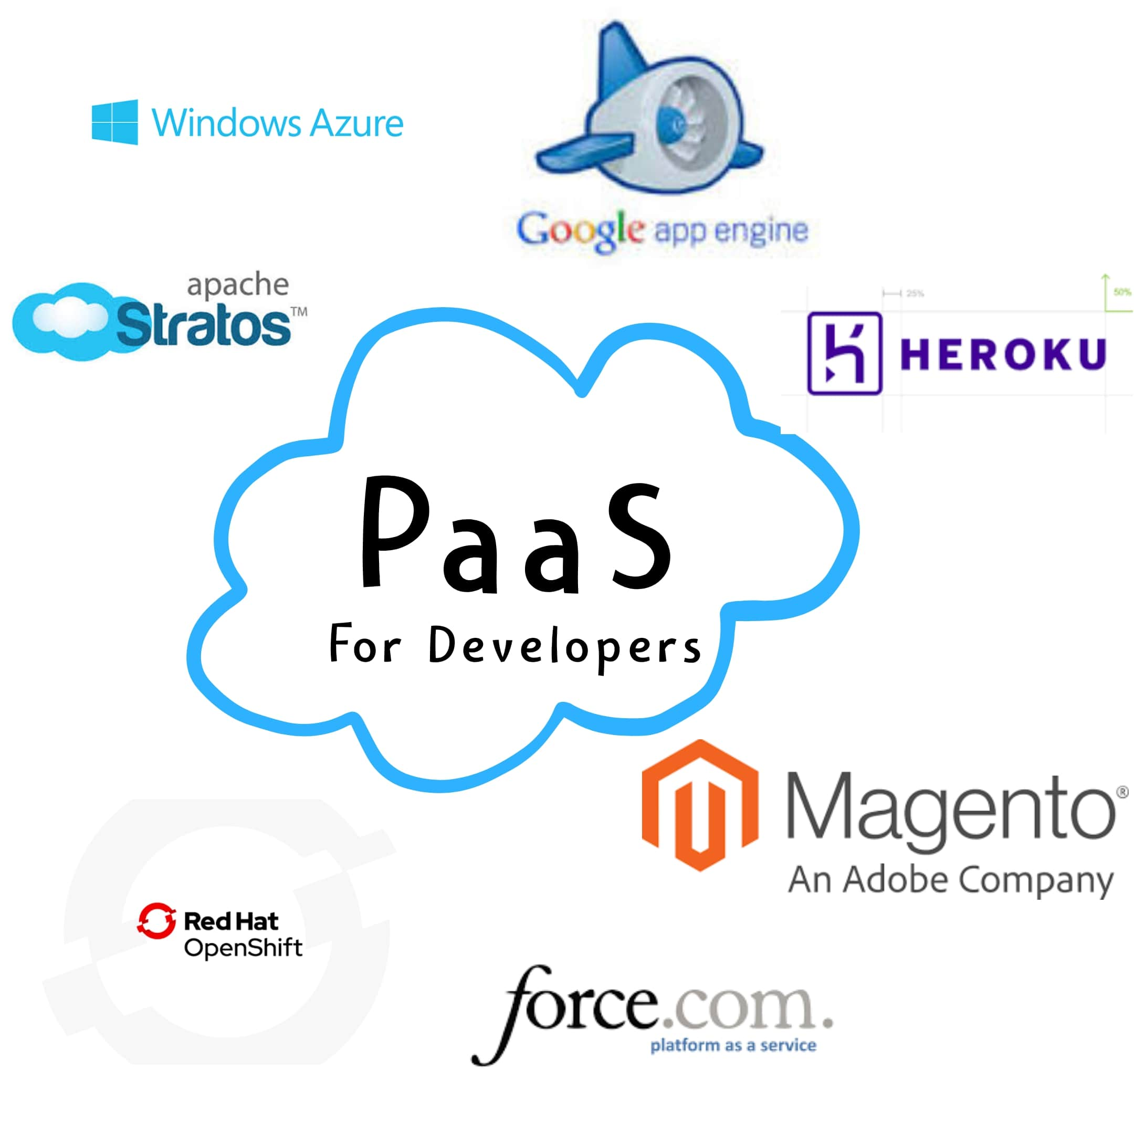
Examples: Platform as a Service (PaaS)
AWS Elastic Beanstalk,
Windows Azure,
Heroku,
Force.com,
Google App Engine,
Apache Stratos,
Magento Commerce Cloud, and OpenShift.

Slide 37
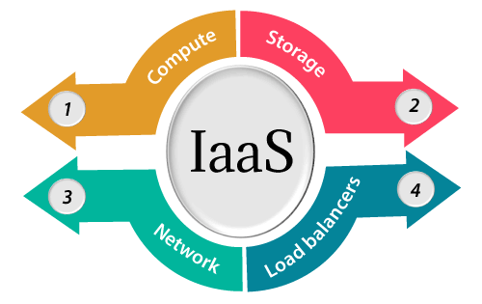
Infrastructure as a Service (IaaS)
IaaS is also known as Hardware as a Service (HaaS).
It is one of the layers of the cloud computing platform.
It allows customers to outsource their IT infrastructures such as servers, networking, processing, storage, virtual machines, and other resources.
Customers access these resources on the Internet using a pay-as-per use model.
IaaS is offered in three models: public, private, and hybrid cloud.

Slide 38
Characteristics of IaaS
IaaS provider provides the following services -
Compute: Computing as a Service includes virtual central processing units and virtual main memory for the Vms that is provisioned to the end- users.
Storage: IaaS provider provides back-end storage for storing files.
Network: Network as a Service (NaaS) provides networking components such as routers, switches, and bridges for the Vms.
Load balancers: It provides load balancing capability at the infrastructure layer.

Slide 39
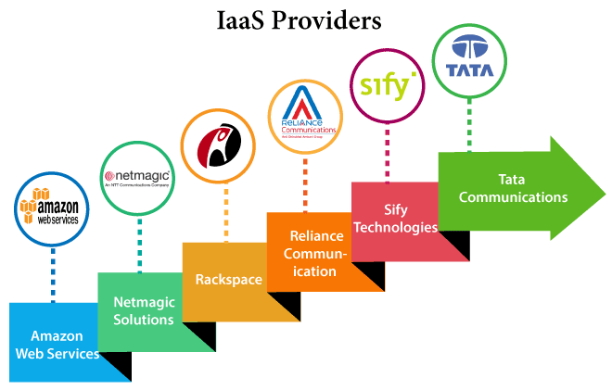
Top IaaS Providers

Slide 40
What is Cloud Security?

Slide 41
An Overview Of Cloud Security
Cloud security is a collection of procedures and technology designed to address external and internal threats to business security.
Organizations need cloud security as they move toward their digital transformation strategy and incorporate cloud-based tools and services as part of their infrastructure.
Without taking active steps to improve their cloud security, organizations can face significant governance and compliance risks when managing client information, regardless of where it is stored.

Slide 42
Cloud Applications

Slide 43
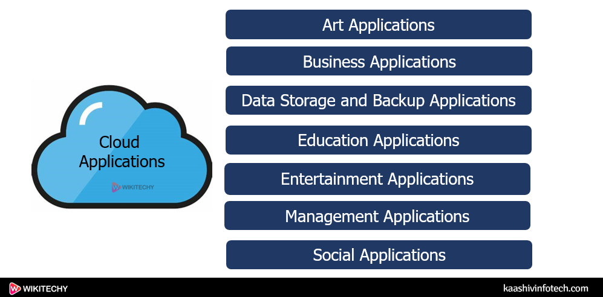

Slide 44

Summary
In this Module, we have discussed
Definition of Cloud Computing
Characteristics of Cloud Computing
Cloud Computing Architecture
Types of Cloud and Computing Services Model
What is Cloud Security?
Applications of Cloud Computing

Slide 45
THANKS!

